Slide 1

Unleashing the Power of Data with Databricks
Databricks is a powerful platform for managing and analyzing big data and can be a valuable tool for organizations looking to gain insights from their data and build data-driven applications.

Slide 2
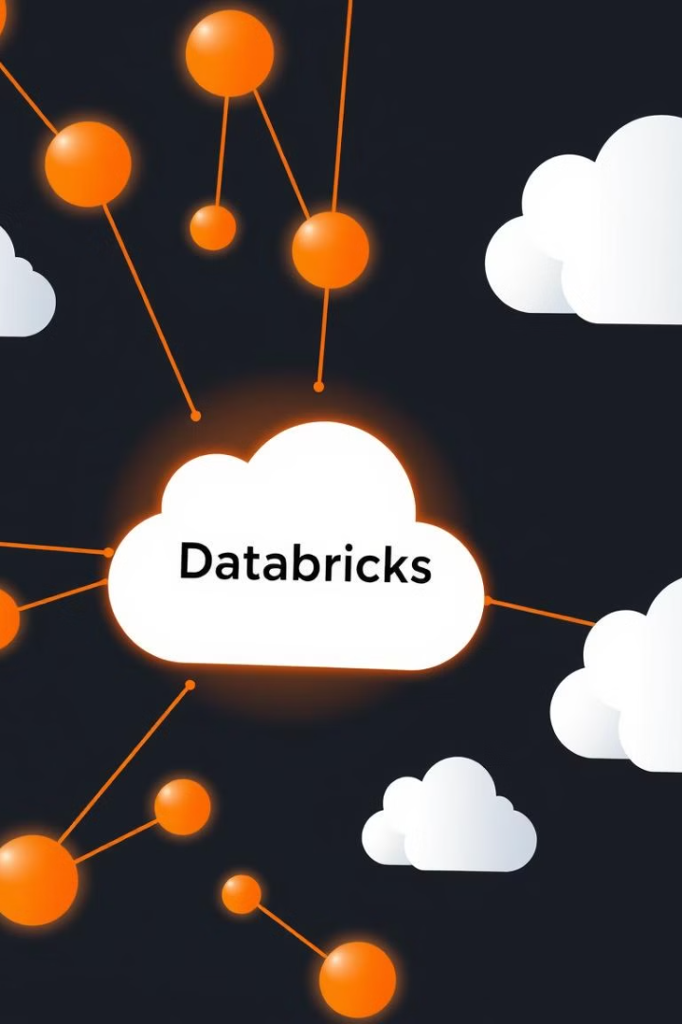
What is Databricks?
A unified platform for big data analytics.
Databricks simplifies data management and analysis using Apache Spark, offering a collaborative workspace for data scientists, engineers, and business analysts.
Cloud-Based Scalability
Accessible and scalable cloud service for all business sizes.

Slide 3
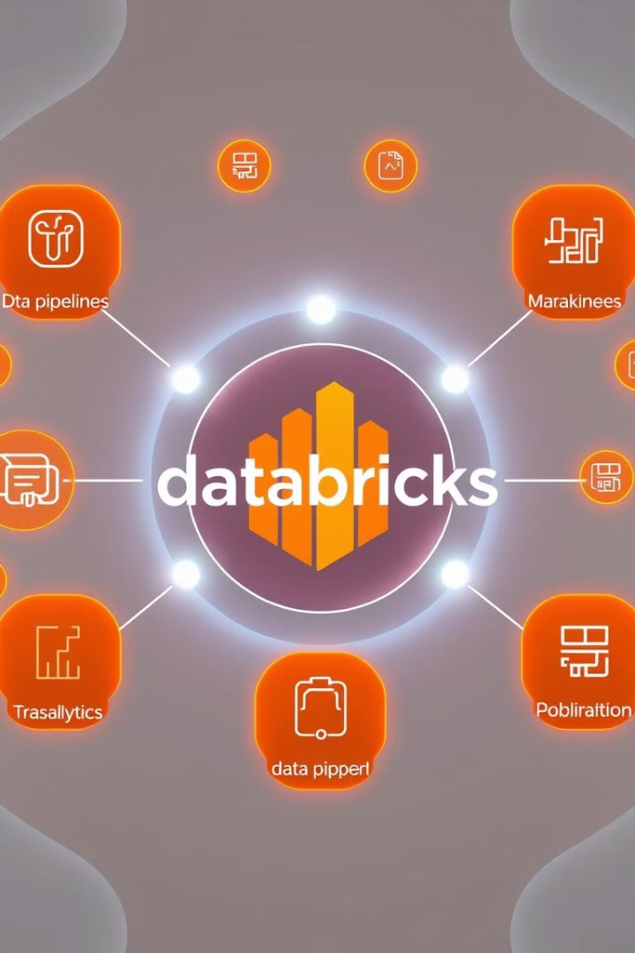
Key Features and Capabilities
Unified Workspace: This can help to improve communication and collaboration within teams and make it easier to develop and deploy data-driven applications.
Scalability & Flexibility: Handles massive datasets and diverse workloads with ease.
Integrated Tools and Services: This makes it easier to build and deploy data-driven applications, without having to worry about setting up and managing complex infrastructure.
Security and Compliance: Databricks takes security and compliance seriously. It supports for encryption, role-based access control, and auditing, as well as integration with popular security and compliance tools.

Slide 4


Delta Lake and Data Warehousing
Delta Lake
1
A scalable and reliable data lake solution that provides ACID transactions, schema enforcement, and time travel capabilities.
Data Warehousing
2
Databricks enables data warehousing, allowing businesses to build and manage data warehouses for efficient data analysis and reporting.

Slide 5

Why Databricks?
1
Process Massive Datasets
2
Develop & Deploy ML Models
Efficiently handle large volumes of data from diverse sources (web logs, sensor data, transactional records) to uncover valuable insights and trends.
Leverage tools like TensorFlow, Keras, and PyTorch to build and train predictive machine learning models for advanced data analysis.
3
Optimize Costs
4
Perform Real-time Analysis
Databricks provides a cost-effective solution for data engineering, machine learning, and analytics, optimizing resource allocation.
Enable real-time monitoring and analysis of streaming data from various sources for timely decision-making and immediate action.

Slide 6




Use Cases and Customer Successes
Personalized Recommendations
Healthcare Analytics
Financial Modeling & Risk Assessment
Real-time Monitoring and Anomaly Detection
Retailers leverage Databricks' powerful analytics capabilities to analyze vast amounts of customer data, encompassing browsing history, purchase patterns, and demographics. This detailed analysis enables the creation of highly personalized product recommendations, delivered seamlessly through various channels such as email, website, and mobile apps. The result is a significant boost in sales conversion rates and enhanced customer satisfaction, fostering loyalty and repeat business.
Healthcare organizations are using Databricks to revolutionize patient care. By analyzing large datasets of patient records, medical images, and research findings, healthcare providers gain critical insights for more accurate diagnoses, optimized treatment plans, and improved patient outcomes. Databricks' robust platform ensures secure and compliant handling of sensitive patient information, while the platform's scalability enables seamless processing of vast datasets, accelerating research and improving clinical decision-making.
Financial institutions rely on Databricks to enhance their predictive modeling capabilities and improve risk assessment. By processing massive financial datasets, Databricks helps institutions create more accurate models for predicting market trends, assessing credit risk, and identifying fraud. The platform's speed and efficiency streamline complex financial analyses, enabling faster and better-informed decision-making.
Companies across various industries, such as manufacturing and transportation, utilize Databricks for real-time monitoring and anomaly detection. By processing high-velocity data streams, Databricks identifies unusual patterns or outliers in real-time, enabling rapid responses to potential problems. This predictive analysis reduces downtime, enhances operational efficiency, and prevents costly disruptions.

Slide 7
The Databricks Advantage
Unified Platform
1
Databricks consolidates data engineering, machine learning, and analytics, providing a single platform for all data-related tasks.
Open and Extensible
2
It offers a wide range of integrations with other tools and services, enhancing flexibility and customization.
Strong Community and Support
3
Databricks has a large and active community, providing ample resources and support for users.

Slide 8

DataBricks Real World Application: Healthcare
Imagine a large hospital system leveraging Databricks to analyze vast datasets of patient records, medical images, and research findings.
This allows for more accurate diagnoses, personalized treatment plans, and improved patient outcomes—leading to enhanced care and reduced costs. The platform's real-time monitoring capabilities enable rapid responses to critical situations, optimizing resource allocation and improving overall efficiency. Secure and compliant handling of sensitive patient information is ensured, accelerating research and improving clinical decision-making.

Slide 9



Conclusion and Thank You
Data-Driven Insights
Strong Partnerships
Future-Proof Solutions
Unlocking the power of data for better decision-making.
Working together to achieve your business goals.
Investing in tomorrow's technology today.

